Slide 1
Understanding How Web Works
02

Slide 2
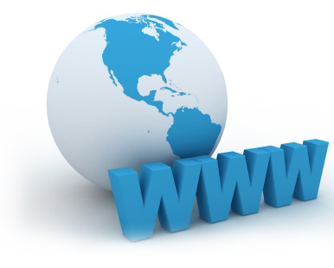
The Web
World Wide Web consists of a large group of computers, known as servers, that exist solely to provide information when that information is requested. The information is requested by a piece of computer software called a web browser.

Slide 3
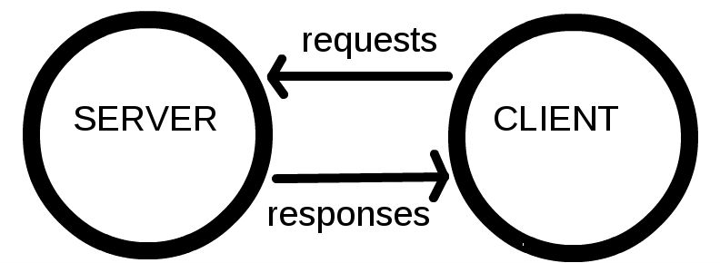
The Web
Web operates on a client-server model, where the client is the web browser and the server is the computer providing, or serving, the information. That information is typically stored in a web page

Slide 4
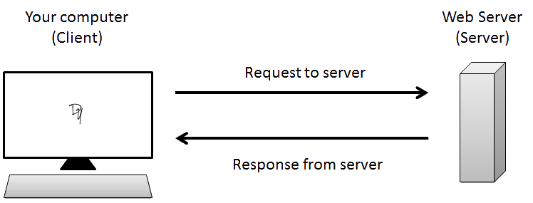
The Web
When a client requests a web page, a web browser such as Microsoft Internet Explorer or Mozilla Firefox (or Safari or Google Chrome or Opera or Lynx) is used.
The web page itself can be a document stored on your computer, just like a word processing document.

Slide 5
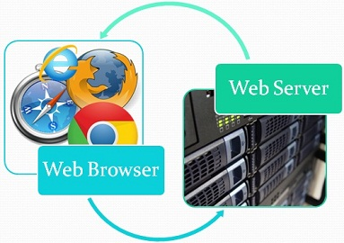
The Web
The web browser knows not only how to open and parse documents formatted for the web, but also how to contact other computers to request documents from them.

Slide 6
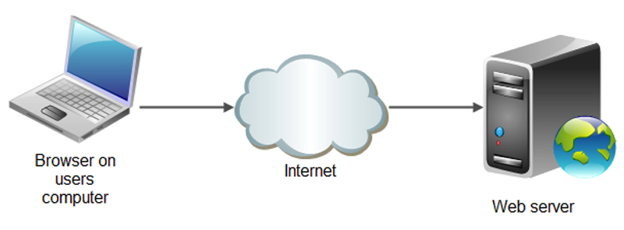
The web server
When a web browser requests a page, it typically contacts a web server. Just as the web browser is software that’s programmed to know how to read and parse web pages, the web server is software that’s programmed to send web pages when they’re requested.

Slide 7
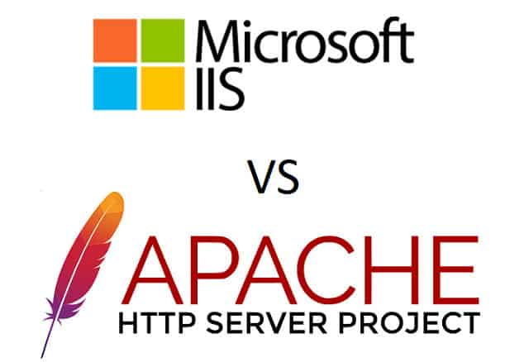
Web Server
Several popular web server software packages are available, but two stand out above the rest:
Apache httpd
Microsoft Internet Information Services (IIS).
Between the two of them, these server software packages are responsible for hosting the vast majority of all web domains.

Slide 8
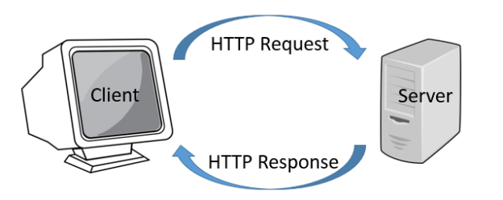
Web Server
Web servers and web browsers talk to each other using a protocol called Hypertext Transfer Protocol, or HTTP. In essence, HTTP is just a way for these two parties to speak to each other.

Slide 9
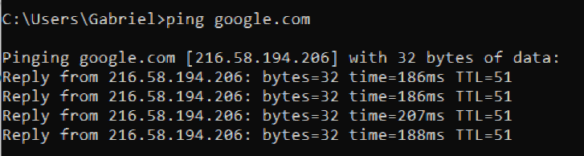
Domain names and IP addresses
Every website needs a unique address on the web. The unique address used by computers to locate a website is the Internet Protocol (IP) address. The most commonly used version of the IP is version 4 (IPv4)

Slide 10
Domain names and IP addresses
Because IP addresses are made up of numbers and dots, they aren’t easy to remember.
Fortunately, there’s a translation service called the Domain Name System (DNS) that provides translation services between IP addresses and friendly host names that are easier to remember.

Slide 11
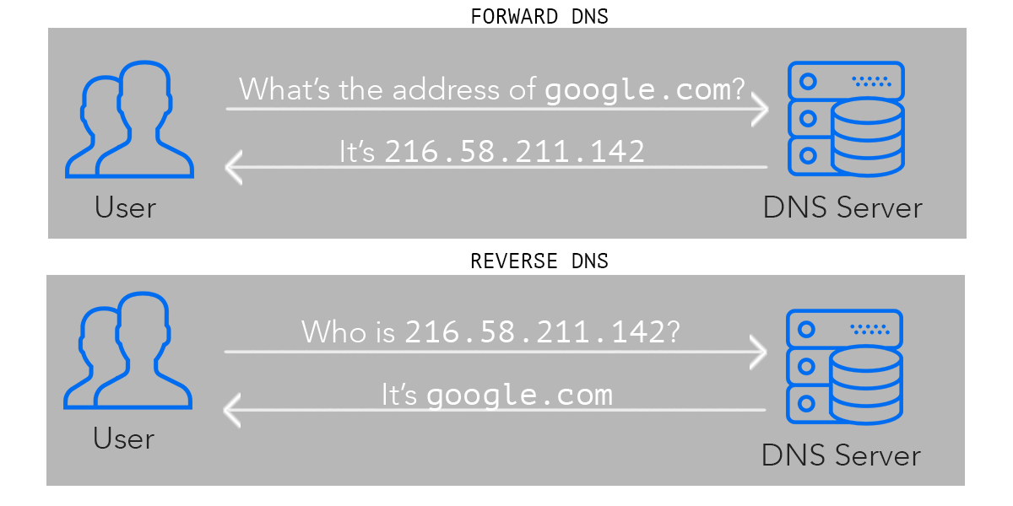

Slide 12
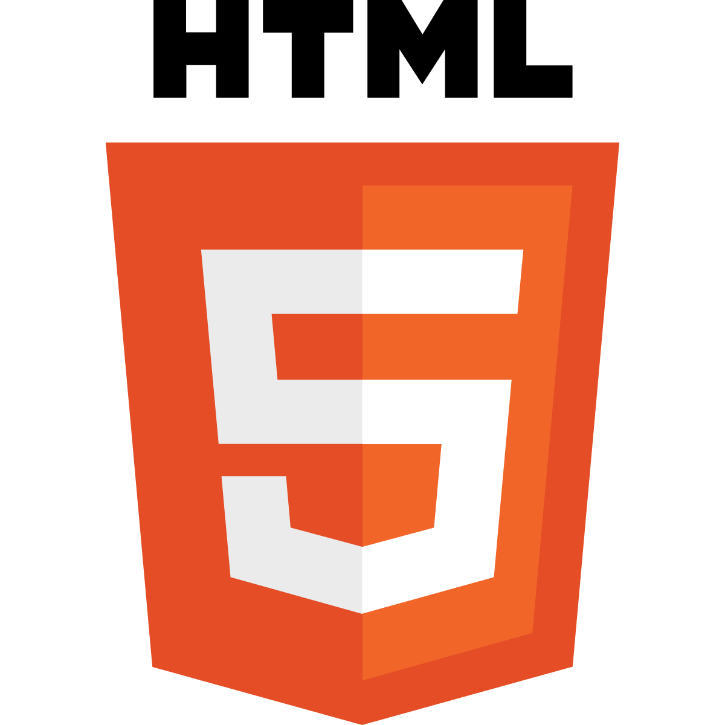
Marking up with HTML
HyperText Markup Language (HTML) provides the behind-the-scenes formatting and layout information for web pages. In much the same way as the behind-the-scenes formatting of a Word document tells Microsoft Word how to display that document, HTML tells the web browser how to display a web page.

Slide 13

Styling pages with CSS
CSS is also used to change the overall appearance of the page itself. For example, CSS can be used to create multi-column layouts, headings on pages, footers, and other display-oriented elements to make the page visually appealing and more usable.

Slide 14
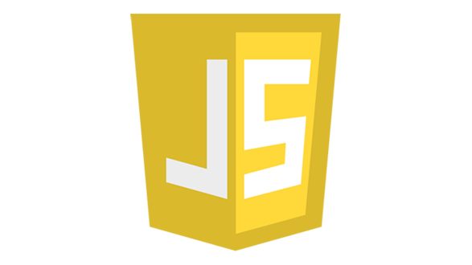
Changing behaviors with JavaScript
JavaScript provides the behavior or actions behind the interactivity that you see on web pages. For example, when you click a button on a web page, chances are there’s a JavaScript program running behind the scenes in order to make the button do something like change a color or move text around on a page.

Slide 15
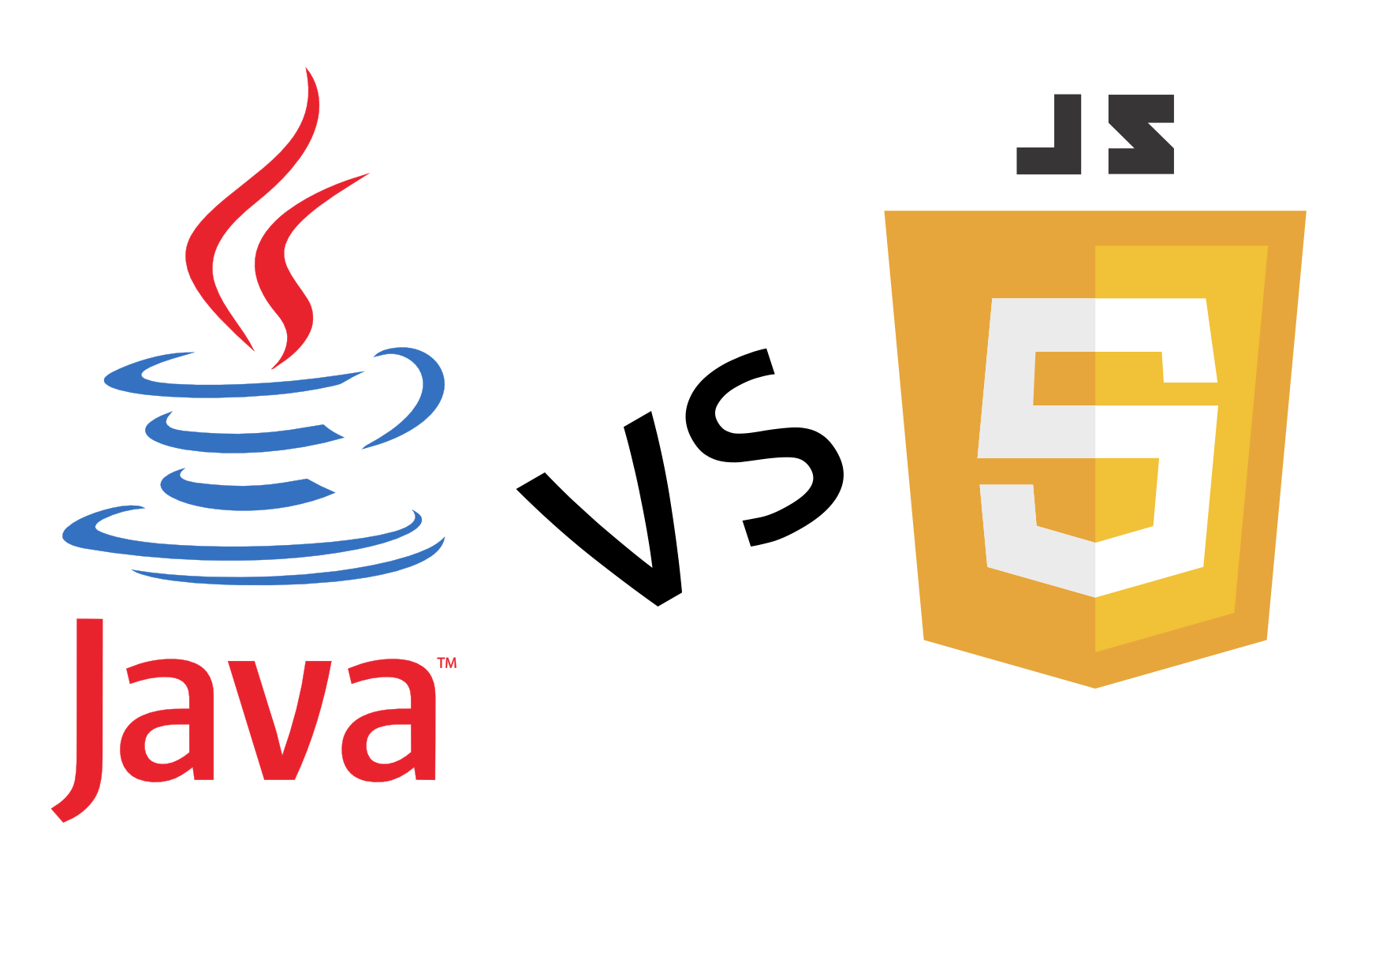
Java vs JavaScript
One misconception about JavaScript is that it’s somehow related to Java: It isn’t. Java and JavaScript are two completely separate languages.
Don’t confuse JavaScript with Java; they’re completely different languages that do completely different things.

Slide 16
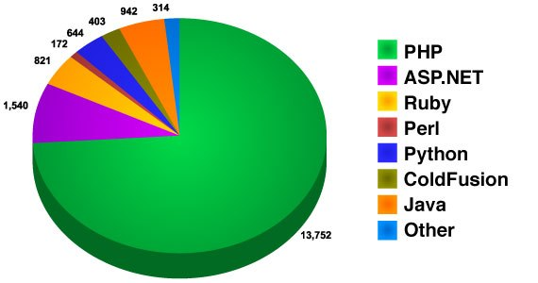
Language of Web Servers
When pages are built dynamically, on-the-fly, a program is running on the
web server to build that page. These programs are called server-side programs.

Slide 17
Language of Web Servers
The program that runs on the server is written in yet another language, aside from the HTML, CSS, and JavaScript that you’ve already seen.
Server side programs for the web can be written in one (or more) of a number of languages. These include Microsoft’s .Net family of languages, Perl, Python
This training will focus on: PHP.

Slide 18

Language of Web Servers
In order for the page to be seen by the user it needs to be sent there. Sending the page to the user is the web server, which in our case will be Apache.
And many sites utilize databases to store information. That’s where MySQL comes in. As you’ll see, MySQL provides a great (and free) way to store data for your website.

Slide 19
Choosing Text Editor

